Slide 1
L09 - Refactoring
Refactoring changes the software structure but does not change the functionality of the program
  important activity during evolution
Refactoring consists of behaviour preserving transformations
  Fowler: Refactoring (book, web site)‏ http://www.refactoring.com/
© 2012 Václav Rajlich Software Engineering: The Current Practice Ch. 1

Slide 2
Two roles of refactoring
Initiation
Prefactoring
  before attempting the actualization
    refactoring will make actualization easier
Postfactoring‏
  prepares software for future evolution
  cleans up the code
Concept Location
Impact Analysis
V
E
R
I
F
I
C
A
T
I
O
N
Prefactoring
Actualization
Postfactoring
Conclusion
© 2012 Václav Rajlich Software Engineering: The Current Practice Ch. 1

Slide 3
Examples of refactoring
Rename an entity
Encapsulate part of the code as a function
  opposite: expand a function in a place of call
Move function into/out of class
Merge and divide classes
  factor out a base class, component class
© 2012 Václav Rajlich Software Engineering: The Current Practice Ch. 1

Slide 4
Extract function
During the software evolution some functions may grow to be too large
Or we may need to separate two concepts the function currently deals with
Extracting part of the function into another function will make it
  easier to understand
  reusable
© 2012 Václav Rajlich Software Engineering: The Current Practice Ch. 1

Slide 5
Extract function example
void foo(char c, int& count)
{
  int i,len;
  char str[MAX];
  cin>>str;
  len=strlen(str);
  count=0;
  for(i=0;i<len;i++)
  if(str[i]==c)
  count++;
}
void foo(char c, int count&)
{
  int len;
  char str[MAX];
  cin>>str;
  len=strlen(str);
  newfun(count,len,str,c);
}
void newfun(int& count,int len, char* str,char c)
{
int i;
count=0;
for(i=0;i<=len;i++)
if(str[i]==c)
count++;
}
© 2012 Václav Rajlich Software Engineering: The Current Practice Ch. 1

Slide 6
Extract function process
Select a block of code for extraction
Is the block syntactically complete?
Create new function
Extract the selected block as a function body
Replace the code block with the function call
© 2012 Václav Rajlich Software Engineering: The Current Practice Ch. 1

Slide 7
Variables during extract function
Local variable
  value assigned inside, used only inside
Parameter passed by value
  value assigned outside
Parameter passed by reference
  value assigned and used outside, changed inside
Global variable
© 2012 Václav Rajlich Software Engineering: The Current Practice Ch. 1

Slide 8
Extract a base class
In code development, derived classes always come before the base classes
  developers may miss some base classes
  refactoring will correct these omissions
Extract a base class prepares software for incorporation of new functionality through polymorphism
  applicable when old and new functionality have a large overlap
© 2012 Václav Rajlich Software Engineering: The Current Practice Ch. 1

Slide 9
Example
class Matrix{
protected:
  int elements [10000], columns, rows;
public:
  Matrix();
  inverse();
  matrix multiply (Matrix&);
  int get (int,int);
  void put(int,int);
}; // dense matrix
© 2012 Václav Rajlich Software Engineering: The Current Practice Ch. 1

Slide 10
Extract class AbstractMatrix
Change request: Add sparse matrix to the code.
  sparse matrix uses the same algorithm for “multiply” and “inverse”.
  only access to the elements are different (functions “get” and “put”)‏
Extract abstract class AbstractMatrix
  DenseMatrix and SparseMatrix will be derived from it
  this will make the change (much) easier
  it will allow to incorporate SparseMatrix through polymorphism
© 2012 Václav Rajlich Software Engineering: The Current Practice Ch. 1

Slide 11
Step 1 of refactoring
Rename class
  class Matrix →class DenseMatrix
There will be several classes dealing with matrix
  name needs to be more specific
© 2012 Václav Rajlich Software Engineering: The Current Practice Ch. 1

Slide 12
The next steps of refactoring and incorporation
2. Extracting base class 3. Incorporating SparseMatrix
DenseMatrix
DenseMatrix
SparseMatrix
AbstractMatrix
AbstractMatrix
© 2012 Václav Rajlich Software Engineering: The Current Practice Ch. 1

Slide 13
Steps of refactoring
Create a new class AbstractMatrix
Make DenseMatrix derived from AbstractMatrix
Move variables columns and rows to AbstractMatrix
Move functions inverse and multiply to AbstractMatrix
Add virtual functions get and set into AbstractMatrix
© 2012 Václav Rajlich Software Engineering: The Current Practice Ch. 1

Slide 14
Results
After refactoring, it is easy to incorporate SparseMatrix
Refactoring preserves the behaviour
© 2012 Václav Rajlich Software Engineering: The Current Practice Ch. 1

Slide 15
Component class extraction
Motivation: Incorporation by replacement
  primitive implementation of the class is replaced by a full functionality
Concept sometimes does not have class of its own
  must be extracted from another class
  prefactoring for incorporation by replacement
© 2012 Václav Rajlich Software Engineering: The Current Practice Ch. 1

Slide 16
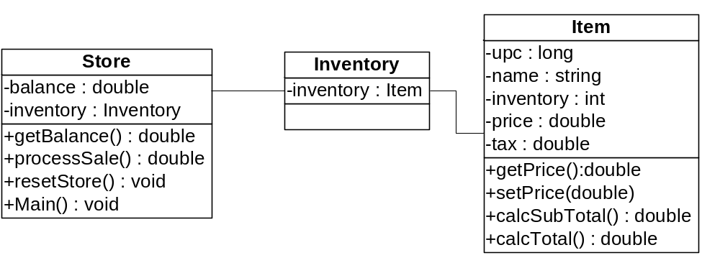
Example: Price in PoS
© 2012 Václav Rajlich Software Engineering: The Current Practice Ch. 1

Slide 17
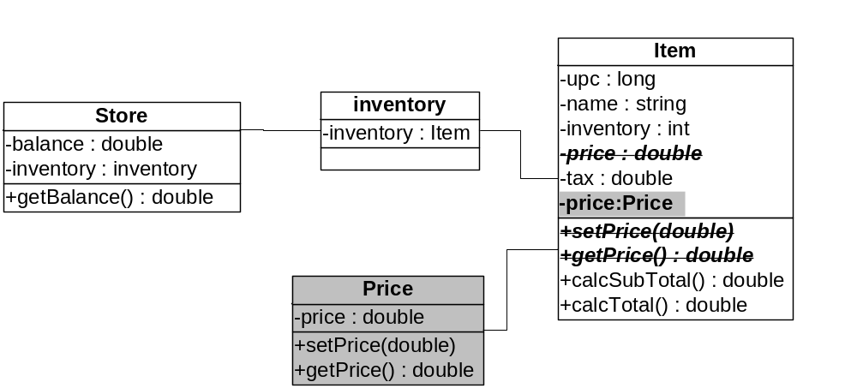
Refactoring
© 2012 Václav Rajlich Software Engineering: The Current Practice Ch. 1

Slide 18
Changes in class Item
  public double calcSubTotal(int numberToSell) {
  if (numberToSell < 1) return 0.0;
  else
  // return numberToSell * price;
  return
  numberToSell*price.getPrice();
  }
© 2012 Václav Rajlich Software Engineering: The Current Practice Ch. 1

Slide 19
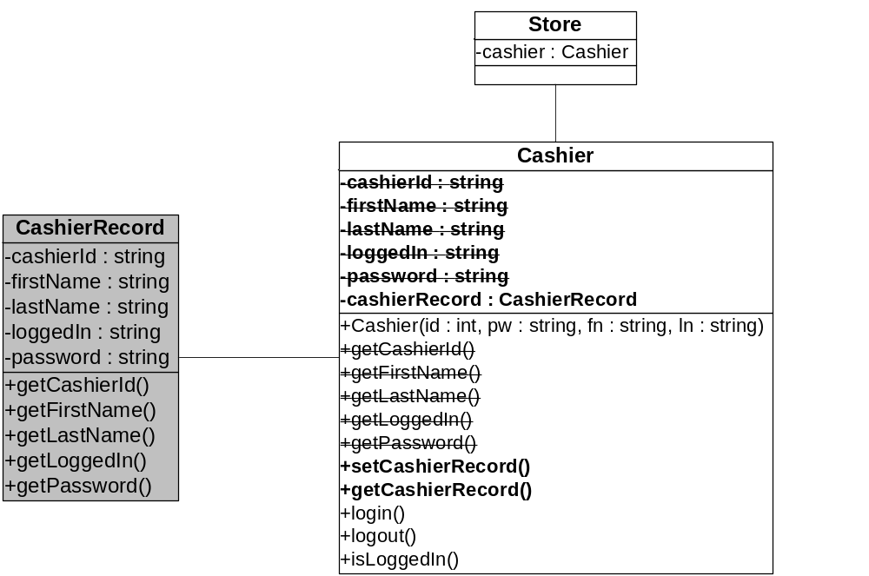
Extract CashierRecord in PoS
© 2012 Václav Rajlich Software Engineering: The Current Practice Ch. 1

Slide 20
Function insertion in C++
A stand-alone function should be a member of a class
Opposite: Function expulsion
  expels member function from a class
© 2012 Václav Rajlich Software Engineering: The Current Practice Ch. 1

Slide 21
Example of function insertion
class A {
public:
int i;
protected:
char c;
};
int foo(A& a) {
a.i = 4;
.
.
.
}
int main() {
A la;
...
foo(la)‏
...
}
© 2012 Václav Rajlich Software Engineering: The Current Practice Ch. 1

Slide 22
Example of function insertion
class A {
public:
int i;
int foo();
protected:
char c;
};
int A::foo() {
this->i = 4;
.
.
.
}
int main() {
A la;
...
la.foo()‏
...
}
© 2012 Václav Rajlich Software Engineering: The Current Practice Ch. 1

Slide 23
Actions of function insertion
The function’s header is inserted into the class specification.
Change access to the members of the target class
The function header must be qualified by the class identifier.
The parameter that is now replaced by membership must be removed.
All function calls must be qualified with a class instance.
All forward declarations of the function are replaced by the new function declaration in the target class specification.
© 2012 Václav Rajlich Software Engineering: The Current Practice Ch. 1

Slide 24
Move function from composite to component
class A { // A is composite
B* b; // B is component
};
    Add a new parameter of the composite type to the function
    Access all component members through the new parameter
    Move the misplaced function from the composite into the component
© 2012 Václav Rajlich Software Engineering: The Current Practice Ch. 1

Slide 25
Move function - example
class A {
public:
B* b;
int a_data;
void a_fun();
void foo();
};
void A::a_fun() {
this->foo();
}
void A::foo(){
//access A
this->...
//access B
b->...
}
class B {
};
class A {
public:
B* b;
int a_data;
void a_fun();
void foo(B*);
};
void A::a_fun() {
this->foo(b);
}
void A::foo(B* lb){
//access A
this->...
//access B
lb->...
}
class B {
};
class A {
public:
B* b;
int a_data;
void a_fun();
};
void A::a_fun(){
b->foo(this);
}
void B::foo(A* d){
//accsess A
d->...
//access B
this->...
}
class B {
public:
void foo(A*);
};
© 2012 Václav Rajlich Software Engineering: The Current Practice Ch. 1

